Slide 1


SINDHE PANDURANG
08-08-2023

Slide 2

Outline
Executive Summary (3)
Introduction (4)
Methodology (6)
Results (16)
Conclusion (46)
Appendix (47)

Slide 3
Executive Summary
- Utilized data from public SpaceX API and SpaceX Wikipedia page.
- Introduced a 'class' column for categorizing successful landings.
- Analyzed data using SQL, data visualization, Folium maps, and interactive dashboards.
- Engineered features, one-hot encoded categorical variables, and standardized data.
- Employed GridSearchCV to optimize machine learning algorithms, achieving around 83.33% accuracy.
- Developed four machine learning models: Logistic Regression, SVM, Decision Tree, KNN.
- Attained consistent 83.33% accuracy across models.
- Models tended to overestimate successful landings.
- Dataset enrichment needed for improved model performance and precision.

Slide 4
Introduction
Background:
Welcome to the era of Commercial Space Exploration.
SpaceX leads with competitive pricing ($62M vs. $165M USD).
Key factor: Rocket part recovery, mainly Stage 1.
The Challenge:
Space Y aims to rival SpaceX's success.
Assigned task: Develop a machine learning model.
Objective: Predict the likelihood of a successful Stage 1 recovery.

Slide 5

Section 1

Slide 6
Methodology
1. Data Gathering Approach:
- Aggregated information from SpaceX's official API and Wikipedia page
2. Outcome Classification:
- Distinguished between successful and unsuccessful landings
3. Exploratory Data Analysis:
- Employed visualization tools and SQL queries
4. Interactive Visual Analytics:
- Utilized Folium for geographical visualizations
- Employed Plotly Dash for interactive data presentation
5. Predictive Analysis:
- Implemented classification models for predictive insights
- Fine-tuned models using GridSearchCV for optimization

Slide 7
Data Collection
Data aggregation involved a blend of Space X public API queries and extracting data from a table in Space X’s Wikipedia page.
Slide 2 illustrates the API-based data collection flow, followed by Slide 3 showcasing the web scraping data collection process.
Space X API Data Columns:
FlightNumber, Date, BoosterVersion, PayloadMass, Orbit, LaunchSite, Outcome, Flights, GridFins,
Reused, Legs, LandingPad, Block, ReusedCount, Serial, Longitude, Latitude
Wikipedia Webscrape Data Columns:
Flight No., Launch site, Payload, PayloadMass, Orbit, Customer, Launch outcome, Version Booster, Booster landing, Date, Time

Slide 8
Data Collection – SpaceX API
GitHub: https://github.com/SindhePandurangBITS/IBM_DS_Professional/blob/a809dddf6357089f018a1a5aa67517f1f76e20ee/jupyter-labs-spacex-data-collection-api.ipynb
Request (Space X APIs)
Filter data to only include Falcon 9 launches
Imputate missing PayloadMass values with mean
.JSON file + Lists(Launch Site, Booster Version, Payload Data)
Cast dictionary to a DataFrame
Json_normalize to DataFrame data from JSON
Dictionary relevant data

Slide 9
Data Collection - Scraping
GitHub:https://github.com/SindhePandurangBITS/IBM_DS_Professional/blob/a809dddf6357089f018a1a5aa67517f1f76e20ee/jupyter-labs-webscraping.ipynb
Request Wikipedia
html
Cast dictionary to DataFrame
Iterate through table cells to extract data to dictionary
BeautifulSoup
html5lib Parser
Find launch info html table
Create dictionary

Slide 10
Data Wrangling
Introduce a binary training label: 1 for success, 0 for failure.
The label derives from two aspects: 'Mission Outcome' and 'Landing Location'.
A new column, 'class', is added to indicate success (1) or failure (0).
Success conditions: True ASDS, True RTLS, True Ocean.
Failure conditions: None, False ASDS, None ASDS, False Ocean, False RTLS.
GitHub url: https://github.com/SindhePandurangBITS/IBM_DS_Professional/blob/a809dddf6357089f018a1a5aa67517f1f76e20ee/IBM-DS0321EN-SkillsNetwork_labs_module_1_L3_labs-jupyter-spacex-data_wrangling_jupyterlite.jupyterlite.ipynb

Slide 11
EDA with Data Visualization
Exploratory Data Analysis performed on variables Flight Number, Payload Mass, Launch Site, Orbit, Class and Year.
Plots Used:
Flight Number vs. Payload Mass, Flight Number vs. Launch Site, Payload Mass vs. Launch Site, Orbit vs. Success Rate, Flight Number vs. Orbit, Payload vs Orbit, and Success Yearly Trend
Scatter plots, line charts, and bar plots were used to compare relationships between variables to
decide if a relationship exists so that they could be used in training the machine learning model
GitHub url: https://github.com/SindhePandurangBITS/IBM_DS_Professional/blob/a809dddf6357089f018a1a5aa67517f1f76e20ee/IBM-DS0321EN-SkillsNetwork_labs_module_2_jupyter-labs-eda-dataviz.ipynb.jupyterlite.ipynb

Slide 12
EDA with SQL
Uploaded dataset into IBM DB2 Database.
Employed SQL-Python integration for querying.
Executed queries to comprehend the dataset.
Extracted details on launch site names, mission outcomes, customer payload sizes, booster versions, and landing results.
GitHub url: https://github.com/SindhePandurangBITS/IBM_DS_Professional/blob/a809dddf6357089f018a1a5aa67517f1f76e20ee/jupyter-labs-eda-sql-coursera_sqllite.ipynb

Slide 13
Build an Interactive Map with Folium
Folium maps mark Launch Sites, successful and unsuccessful landings, and a proximity example to key locations: Railway, Highway, Coast, and City.
This allows us to understand why launch sites may be located where they are. Also visualizes successful landings relative to location.
GitHub url:
https://github.com/SindhePandurangBITS/IBM_DS_Professional/blob/a809dddf6357089f018a1a5aa67517f1f76e20ee/IBM-DS0321EN-SkillsNetwork_labs_module_3_lab_jupyter_launch_site_location.jupyterlite.ipynb

Slide 14
Build a Dashboard with Plotly Dash
The dashboard features a pie chart displaying overall successful landing distribution and site-specific success rates.
It also includes a scatter plot for exploring success across sites, payload mass, and booster versions.
The scatter plot's inputs are launch sites and payload mass (0-10000 kg).
GitHub url:
https://github.com/SindhePandurangBITS/IBM_DS_Professional/blob/a809dddf6357089f018a1a5aa67517f1f76e20ee/IBM-DS0321EN-SkillsNetwork_labs_module_3_lab_jupyter_launch_site_location.jupyterlite.ipynb

Slide 15
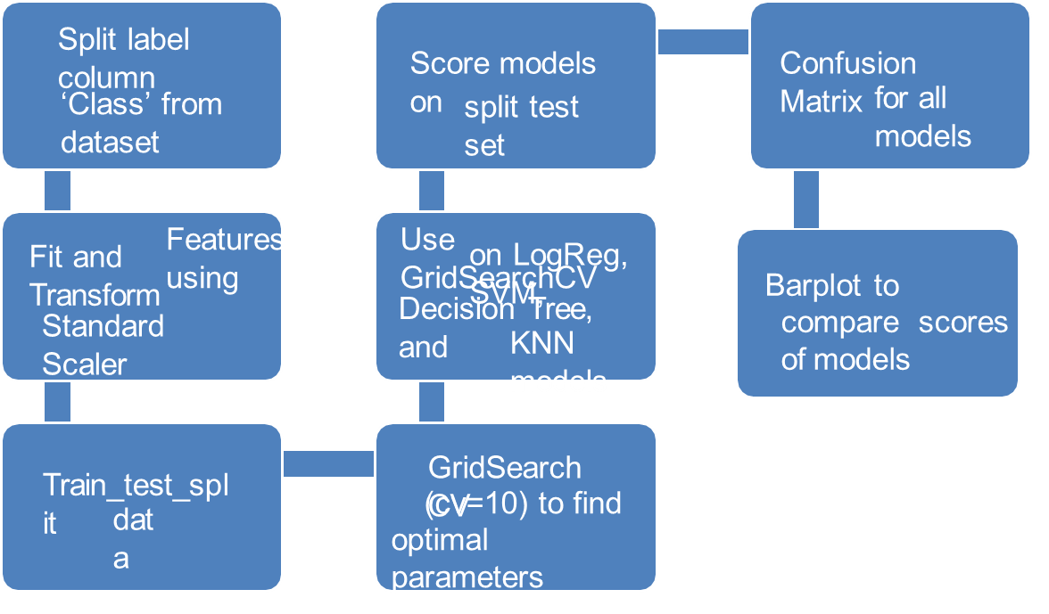
Predictive Analysis (Classification)
GitHub Url:
https://github.com/SindhePandurangBITS/IBM_DS_Professional/blob/a809dddf6357089f018a1a5aa67517f1f76e20ee/IBM-DS0321EN-SkillsNetwork_labs_module_4_SpaceX_Machine_Learning_Prediction_Part_5.jupyterlite.ipynb

Slide 16
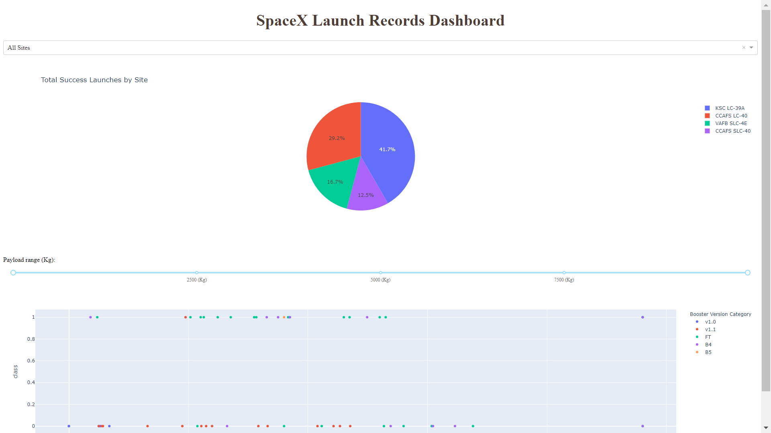
Results
This is a preview of the Plotly dashboard. The following sides will show the results of EDA with visualization, EDA with SQL, Interactive Map with Folium, and finally the results of our model with about 83% accuracy.

Slide 17

Section 2

Slide 18
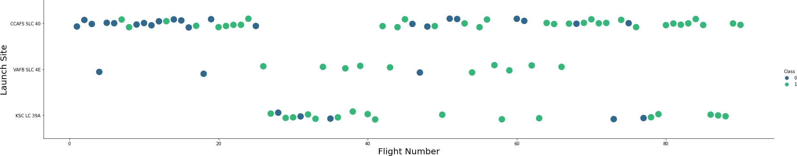
Flight Number vs. Launch Site
Graphic suggests an increase in success rate over time (indicated in Flight Number). Likely a big breakthrough around flight 20 which significantly increased success rate. CCAFS appears to be the main launch site as it has the most volume.

Slide 19
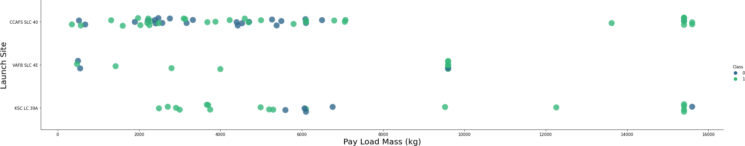
Payload vs. Launch Site
Payload mass appears to fall mostly between 0-6000 kg.
Different launch sites also seem to use different payload mass.

Slide 20
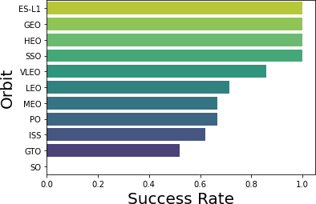
Success Rate vs. Orbit Type
ES-L1 (1), GEO (1), HEO (1) have 100% success rate (sample sizes in parenthesis) SSO (5) has 100% success rate
VLEO (14) has decent success rate and attempts
SO (1) has 0% success rate
GTO (27) has the around 50% success rate but largest sample

Slide 21
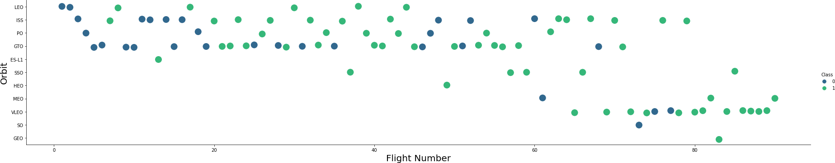
Flight Number vs. Orbit Type
Launch Orbit preferences changed over Flight Number. Launch Outcome seems to correlate with this preference.
SpaceX started with LEO orbits which saw moderate success LEO and returned to VLEO in recent launches SpaceX appears to perform better in lower orbits or Sun-synchronous orbits

Slide 22
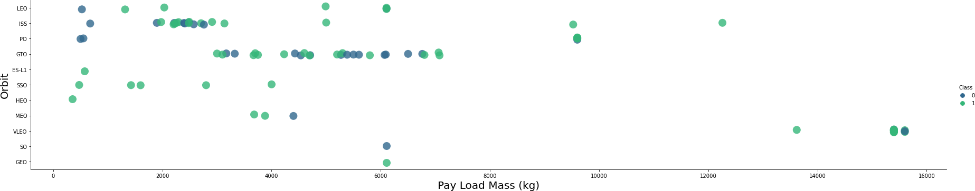
Payload vs. Orbit Type
Payload mass seems to correlate with orbit
LEO and SSO seem to have relatively low payload mass
The other most successful orbit VLEO only has payload mass values in the higher end of the range

Slide 23
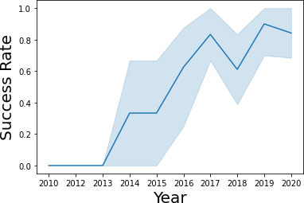
Launch Success Yearly Trend
Success generally increases over time since 2013 with a slight dip in 2018
Success in recent years at around 80%

Slide 24
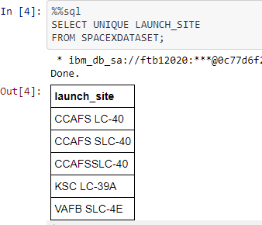
All Launch Site Names
Query unique launch site names from database.
CCAFS SLC-40 and CCAFSSLC-40 likely all represent the same
launch site with data entry errors.
CCAFS LC-40 was the previous name. Likely only 3 unique launch_site values: CCAFS SLC-40, KSC LC-39A, VAFB SLC-4E

Slide 25
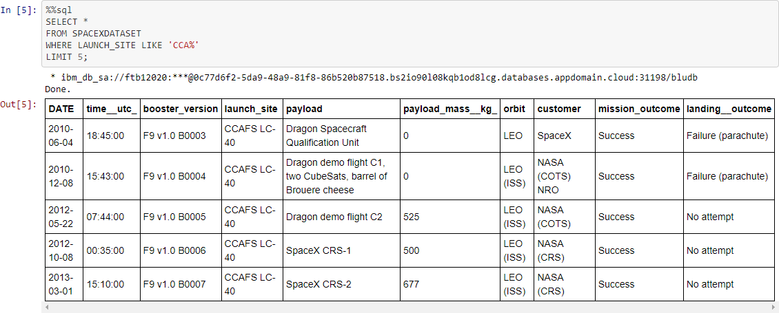
Launch Site Names Begin with 'CCA'
First five entries in database with Launch Site name beginning with CCA.

Slide 26
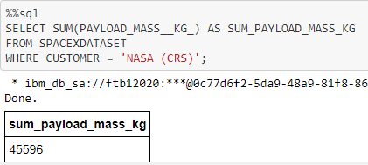
Total Payload Mass
This query sums the total payload mass in kg where NASA was the customer.
CRS stands for Commercial Resupply Services which indicates that these payloads were sent to the International Space Station (ISS).

Slide 27
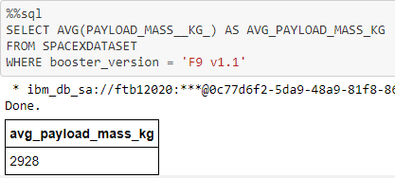
Average Payload Mass by F9 v1.1
This query calculates the average payload mass or launches which used booster version F9 v1.1
Average payload mass of F9 1.1 is on the low end of our payload mass range

Slide 28
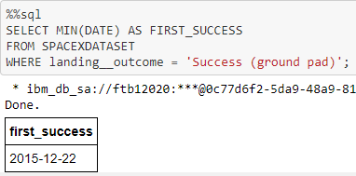
First Successful Ground Landing Date
This query returns the first successful ground pad landing date.
First ground pad landing wasn’t until the end of 2015.
Successful landings in general appear starting 2014.

Slide 29
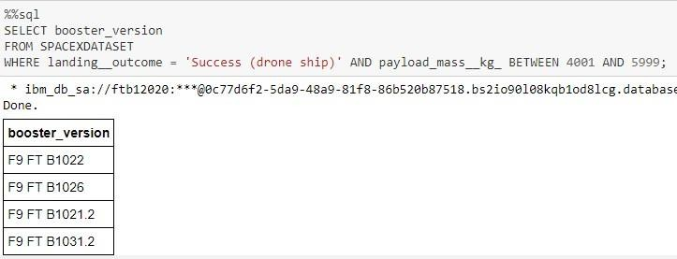
Successful Drone Ship Landing with Payload between 4000 and 6000
This query returns the four booster versions that had successful drone ship landings and a payload mass between 4000 and 6000 non inclusively.

Slide 30
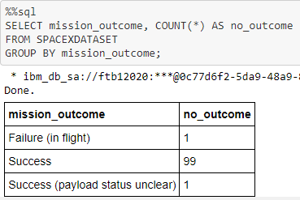
Total Number of Successful and Failure Mission Outcomes
This query returns a count of each mission outcome.
SpaceX appears to achieve its mission outcome nearly 99% of the time.
This means that most of the landing failures are intended.
Interestingly, one launch has an unclear payload status and unfortunately one failed in flight.

Slide 31
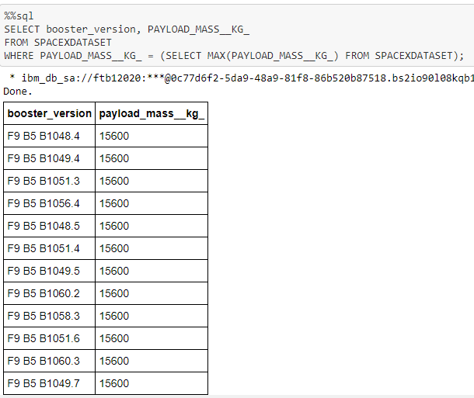
Boosters Carried Maximum Payload
The query identifies F9 B5 B10xx.x booster versions that transported the maximum 15600 kg payload mass, suggesting a strong correlation.
These similar booster versions strongly imply that the choice of booster version relates to the payload mass requirement.

Slide 32
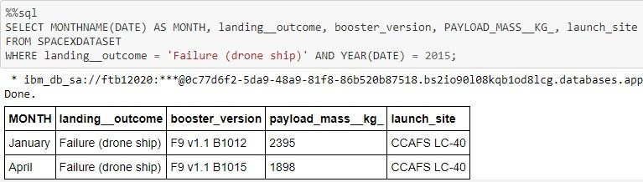
2015 Launch Records
Query retrieves details of 2015 launches: Month, Landing Outcome, Booster Version, Payload Mass (kg), and Launch site. Specifically focuses on stage 1 failures to land on drone ship.
Identifies two instances of such failures in 2015.

Slide 33
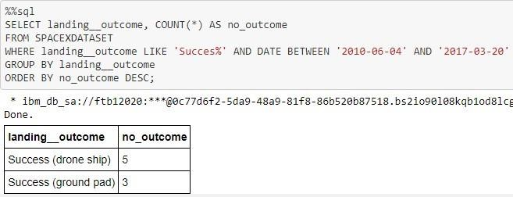
Rank Landing Outcomes Between 2010-06-04 and 2017-03-20
The query provides a list of 8 successful landings between June 4, 2010, and March 20, 2017, including both drone ship and ground pad outcomes.
Launch sites are depicted on maps: the left map displays all sites on the US map, while the right map focuses on the two closely situated launch sites in Florida, all of which are near the ocean.

Slide 34

Section 3

Slide 35

Launch Site Locations
The left map illustrates global launch sites in relation to the US map, while the right map specifically focuses on the close proximity of the two Florida launch sites.
All launch sites are strategically located near ocean areas.

Slide 36

Color-Coded Launch Markers
Clickable clusters on Folium map reveal successful (green) and failed (red) landings.
VAFB SLC-4E illustrates 4 successful and 6 failed landings in this instance.

Slide 37



Key Location Proximities
Launch sites like KSC LC-39A are strategically located near railways and highways, facilitating efficient large-scale supply transportation as well as human transit.
These launch sites are positioned near coasts, ensuring safe sea landings for launch failures and preventing rocket debris from endangering densely populated urban areas.

Slide 38

Section 4

Slide 39


Successful Launches Across Launch Sites
Successful landings distributed across launch sites: CCAFS SLC-40 (formerly CCAFS LC-40) and KSC have equal successes due to name change, mainly prior to it.
VAFB shows the lowest success share, possibly due to its smaller sample and higher west coast launch challenges

Slide 40

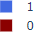
Highest Success Rate Launch Site
KSC LC-39A has the highest success rate with 10 successful landings and 3 failed landings.

Slide 41

Payload Mass vs. Success vs. Booster Version Category
Plotly dashboard's Payload range selector limited to 0-10000, not reflecting the max Payload of 15600.
Class 1 indicates successful, 0 for failed landing. Scatter plot uses color for booster version and point size for launches.
Notably, within the range 0-6000, two failed landings occurred with payloads of zero kg.

Slide 42

Section 5

Slide 43

Classification Accuracy
All models demonstrated similar performance with an 83.33% accuracy on the test set. Worth mentioning, the test set consisted of only 18 samples, which is relatively small.
The limited test size of 18 samples could lead to significant fluctuations in accuracy scores. This was evident in the variability of accuracy results observed during repeated runs of the Decision Tree Classifier model.
A larger dataset is required to enhance the reliability of model selection and performance evaluation.

Slide 44

Confusion Matrix
Since consistent results were observed among all models on the test set, the confusion matrix remained consistent as well. The model forecasts aligned with true outcomes in 12 instances of successful landings.
In cases of unsuccessful landings, the models accurately predicted 3 occurrences, but also made 3 incorrect successful landing predictions (false positives). This reveals a tendency for our models to overestimate successful landings.

Slide 45
Conclusions
Objective: Develop a machine learning model for Space Y to compete with SpaceX.
Aim: Predict successful Stage 1 landing to save around $100 million USD.
Data Sources: Utilized SpaceX API and web scraping of SpaceX Wikipedia.
Data Handling: Labels generated, data stored in DB2 SQL database.
Visualization: Created a dashboard for clear data representation.
Achievements: Built ML model with 83% accuracy.
Practicality: Enables SpaceY to predict successful Stage 1 landing, aiding launch decisions.
Future Steps: Collect more data to enhance ML model for improved accuracy.

Slide 46
Appendix
GitHub repository url:
https://github.com/SindhePandurangBITS/IBM_DS_Professional.git
Instructors:
Instructors: Rav Ahuja, Alex Aklson, Aije Egwaikhide, Svetlana Levitan, Romeo Kienzler, Polong Lin, Joseph Santarcangelo, Azim Hirjani, Hima Vasudevan, Saishruthi Swaminathan, Saeed Aghabozorgi, Yan Luo
Special Thanks to All Instructors:
https://www.coursera.org/professional-certificates/ibm-data-science?#instructors

Slide 47


